Slide 1

WELCOME TO
PRESENTATION

Slide 2
C PROGRAMMING
Submitted To : Submitted by : Vikas kumar Mrs. Divya Maheshwari Bipin kumar
Diwas gupta
Abhishek

Slide 3
Objectives
In this presentation we will learn some basic topics in c language such as-
What is pre-processor directives(#).
What is storage class.
What is string.

Slide 4
Outcomes
After some time we will develop our basic concept about this topic such as-
What is pre-processor directives , what is use of this. which symbol is use for representation etc.
And we will also learn what is storage class ,types of storage class ,why we are using in our programs and what is the syntax for use etc.
And the main is what is string, how we are use , why we are use, what is advantages and disadvantages string etc.
Now, lets start..

Slide 5

Pre-processor Directives
Pre-processor are program that process our source code before compilation.
The pre-processor directives give instructions to the compiler to pre-process the information before actual compilation starts.
All the pre-processor directives begin with # symbol and only white space character may appear before a pre-processor directive on line.
Pre-processor directives are not statement so they do not end with the semicolon(;).

Slide 6
Process flow of pre-processor directives
C program
Are there pre-processor or directives
Object code
No
compiler
linker
Executable code
Pre-processor perform action

Slide 7
Storage class
Storage Classes are used to describe the features of a variable/function.
These features basically include the scope, visibility and life-time which help us to trace the existence of a particular variable during the runtime of a program.

Slide 8
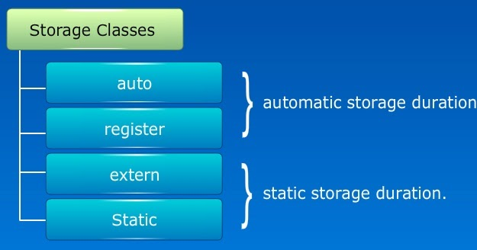

Slide 9

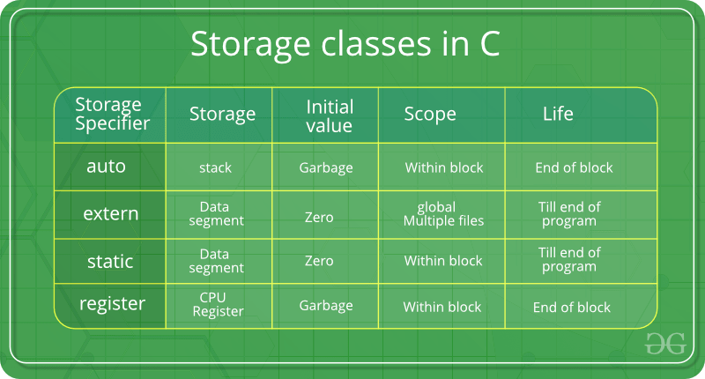

Slide 10

Automate
This is default storage class for all variables declare inside a function or a block.
The automatic variables are initialize to garbage .
The keyword used for defining automatic variables is ‘auto’.

Slide 11
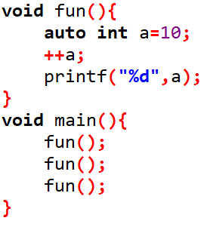

Example of automate

Slide 12

extern or External
External storage class tells that variable is define else where and not within the same block where it is used.
An external variable is global variable initialized with a legal value where it is declared in order to be used else where.
A global variable can be made external by placing ‘extern’ keyword before its declaration.
Example
#include(){
extern int a;
printf(“%d”,a);
}
Output: something is error in the program.

Slide 13
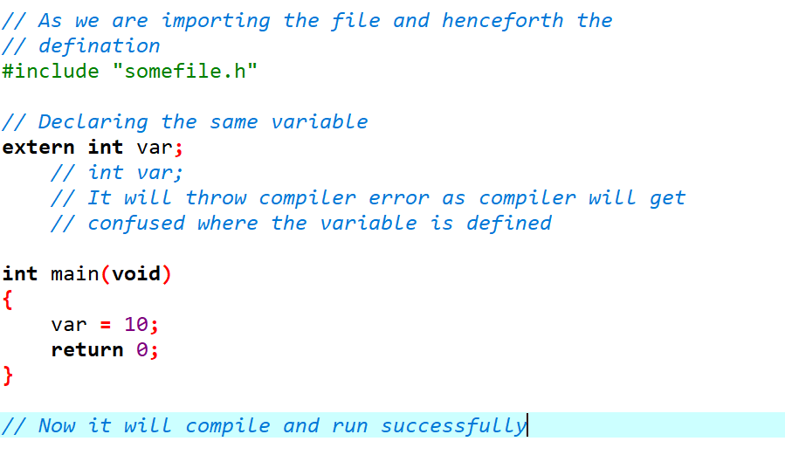
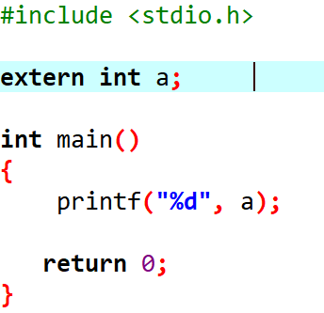
Example of extern

Slide 14

Static
This storage class is used to declare static variable .
Static variable have the property of preserving there value even after they are out off scope.
Static variables exist till the terminating of the program.

Slide 15
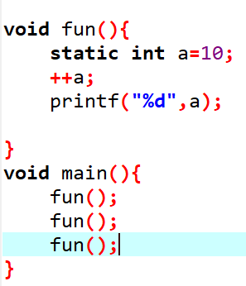
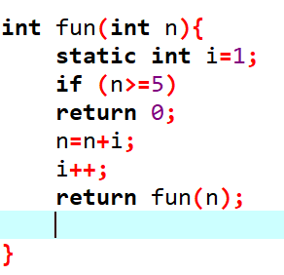
Example of static

Slide 16

register
Register are faster than memory to access, so the variables which are most frequently used in c program can be put in register using ‘register’ key word.
The keyword hints to compiler that a give a number variable can be put in a register.
example:
#include<stdio.h>
int main(){
register int a=10;
printf(“%d”,a);
}
Output: 10

Slide 17
string
Introduction of array in C programming.
Advantages of array in C programming.
Disadvantages of array in C programming.

Slide 18
INTRODUCTION OF ARRAY
Arrays are used to store multiple values in a single variable.
It is instead of declaring separate variables for each value.
To create an array, define the data type (like int).
Array followed by square brackets [].
To insert values to it, use a comma-separated list, inside curly braces
Example
int myNumbers[] = {25, 50, 75, 100};

Slide 19
Program of array in c language.
#include<stdio.h>
Int main()
{
int my number [ ] = {25,30,75,100};
printf(“%d”,my number[0]); OUTPUT = 25
return 0;
}

Slide 20
ADVANTAGES OF ARRAY IN C PROGRAMMING
Arrays help in code optimization.
Along with simple arrays, we also have 2- dimensional arrays, which are used to store elements of a matrix of any dimensions
The time complexity to access any element of an array is O(1)

Slide 21
DISADVANTAGES OF ARRAY IN C PRIRAMMING
The size of an array is fixed.
Allocating less memory than the required to an array leads to loss of data.
A single array cannot store values of different data types, i.e an array is homogenous in nature.

Slide 22

A very

